Slide 1
LOGICAL DATABASE DESIGN
IE2042 | DMSS | Logical Design | Dr. Harinda Fernando

Slide 2

Learning Outcomes (LO1)
Understand the process of logical database design
Understand the relational model and its components
Explain the integrity constraints
Ability to convert an EER diagram to a relational model
IE2042 | DMSS | Logical Design | Dr. Harinda Fernando
IE2042 | DMSS | Logical Design | Dr. Harinda Fernando

Slide 3
The Relational Model
A relational database is a collection of relations with distinct relation names
The main construct of the relation model is the relation
A relation consist of;
Relational Schema
Relational Instance
IE2042 | DMSS | Logical Design | Dr. Harinda Fernando

Slide 4
Relation Mapping
IE2042 | DMSS | Logical Design | Dr. Harinda Fernando

Slide 5
Mapping ER models to relations
What is a relation?
A relation is a table that holds the data we are interested in. It is two-dimensional and has rows and columns.
Each entity type in the ER model is mapped into a relation.
The attributes become the columns.
The individual entities become the rows.
IE2042 | DMSS | Logical Design | Dr. Harinda Fernando

Slide 6
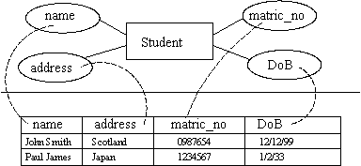
Example
IE2042 | DMSS | Logical Design | Dr. Harinda Fernando

Slide 7
The Relational Model
Relation Schema = Relation Name + Each Field Name + Each Field's Domain
Student (sID:integer , sName:varchar(20) , Age:integer)
Relation Instance = Set of tuples/ Records in the database
sID | sName | Age
1356 | Kasun | 22
6832 | Rayan | 20
IE2042 | DMSS | Logical Design | Dr. Harinda Fernando

Slide 8
Example
Relations can be represented textually as:
tablename(primary key, attribute 1, attribute 2, ... , foreign key)
If roll_num was the primary key, and there were no foreign keys, then the table above could be represented as:
student(roll_num, name, address, date_of_birth)
IE2042 | DMSS | Logical Design | Dr. Harinda Fernando

Slide 9
Integrity Constraints
Integrity Constraint is a rule/ condition enforced by the DBMS to ensure only correct data is stored in the database
If an instance satisfies all the integrity constraints specified on the database schema; then the instance is Legal
Types of integrity constraints are;
Domain Constraints
Key Constraints
Referential Constraints
Other Constraints
IE2042 | DMSS | Logical Design | Dr. Harinda Fernando

Slide 10
Domain Integrity Constraints
Specifies that the values in a column must be from the domain specified
Data types are used to validate the domain
GPA should be a float
IE2042 | DMSS | Logical Design | Dr. Harinda Fernando

Slide 11
Key Integrity Constraints
Unique and Primary key
The minimum set of attributes that uniquely identifies a tuple = KEY
Cannot insert many records to the Student table from one sID
IE2042 | DMSS | Logical Design | Dr. Harinda Fernando

Slide 12
Referential Integrity Constraints
Enforced by Foreign Keys
Specified between two relations to maintain consistency among tuples in the two relations
A tuple in one relation that refers to another relation must refer to an existing tuple in that relation
Both domains should be equal
Should refer existing values
IE2042 | DMSS | Logical Design | Dr. Harinda Fernando

Slide 13
Other Integrity Constraints (Table & Assertions)
Table Constraints
Constraints within a single table
Use CHECK constraints
The account balance of the account table should be always greater than zero
(AccTable-Balance>0)
Assertions
Constraints between multiple tables
Use Triggers
The employee salary should not exceed his managers salary
(EmpTable- see salary details & DeptTable- find his manager)
IE2042 | DMSS | Logical Design | Dr. Harinda Fernando

Slide 14
Entities, Attributes & Keys
Name
Phone
Street
DOB
Address
Employee
Employee ()
City
EmpID
Employee (NIC, Name, DOB)
NIC
Age
Employee (EmpID, NIC, Name, DOB)
Employee (EmpID, NIC, Name, DOB, Street, City)
Employee_Phone (EmpID, Phone)
IE2042 | DMSS | Logical Design | Dr. Harinda Fernando

Slide 15
Logical Mapping For Simple Relationships
IE2042 | DMSS | Logical Design | Dr. Harinda Fernando

Slide 16
Mapping 1:1 relationships
Before tackling a 1:1 relationship, we need to know its optionality.
There are three possibilities the relationship can be:
mandatory at both ends
mandatory at one end and optional at the other
optional at both ends
IE2042 | DMSS | Logical Design | Dr. Harinda Fernando

Slide 17
Mandatory at both ends
If the relationship is mandatory at both ends it is often possible to subsume one entity type into the other.
One of the keys are used as primary key
Combined table contains all attributes from both tables with duplicates removed
Else the tables can be kept separate and connected using a foreign key
IE2042 | DMSS | Logical Design | Dr. Harinda Fernando

Slide 18
Mandatory at both ends
EMPLOYEE (eid, name, regDate)
regDate
eid
1
has
1
EMPLOYEE
PERSONAL FILE
fno
name
c
EMPLOYEE (eid, name)
EMPLOYEE (eid, name, )
fno
eid
PERSONAL FILE (fno, regDate, )
PERSONAL FILE (fno, regDate)
If there is a descriptive attribute -> It is included in the foreign key side
18
IE2042 | DMSS | Logical Design | Dr. Harinda Fernando

Slide 19

Mandatory <-> Optional
The entity type of the optional end can be subsumed into the mandatory end as in the previous example.
But should not be integrated as this will create null entries.
It is better to include the foreign key in the optional side so as to avoid null entries.
IE2042 | DMSS | Logical Design | Dr. Harinda Fernando

Slide 20

Optional at both ends...
Such examples cannot be amalgamated as you could not select a primary key.
Instead, one foreign key is used as before (which table is your choice).
IE2042 | DMSS | Logical Design | Dr. Harinda Fernando

Slide 21

Mapping 1:m relationships
Cannot be amalgamated
To map 1:m relationships, the primary key on the ‘one side’ of the relationship is added to the ‘many side’ as a foreign key.
For example, the 1:m relationship ‘course-student’:
IE2042 | DMSS | Logical Design | Dr. Harinda Fernando

Slide 22
Mapping 1:m relationships
1:M
Dname
eid
M
has
1
EMPLOYEE
DEPARTMENT
Dno
name
c
DEPARTMENT (Dno, Dname)
1 side's PK will go to M side
Dno
, c
EMPLOYEE (eid, name, )
Even if total participation is available, no priorities will come in to play.
Schema will not change
22
IE2042 | DMSS | Logical Design | Dr. Harinda Fernando

Slide 23

Mapping n:m relationships
If you have some m:n relationships in your ER model then these are mapped in the following manner.
A new relation is produced which contains the primary keys from both sides of the relationship
These primary keys form a composite primary key.
IE2042 | DMSS | Logical Design | Dr. Harinda Fernando

Slide 24

Mapping n:m relationships
This is equivalent to:
Student(matric_no,st_name,dob)
Module(module_no,m_name,level,credits)
Study()
IE2042 | DMSS | Logical Design | Dr. Harinda Fernando

Slide 25
Mapping n:m relationships
M:M
Pname
eid
Works_for
EMPLOYEE
PROJECT
Pno
name
c
EMPLOYEE (eid, name)
Create a new relation for the relationship including both PK's
PROJECT (Pno, Pname)
WORKS_FOR (eid, Pno, c)
IE2042 | DMSS | Logical Design | Dr. Harinda Fernando

Slide 26
Summary
1-1 relationships
Depending on the optionality of the relationship, the entities are either combined or the primary key of one entity type is placed as a foreign key in the other relation.
1-m relationships
The primary key from the ‘one side’ is placed as a foreign key in the ‘many side’.
m-n relationships
A new relation is created with the primary keys from each entity forming a composite key.
IE2042 | DMSS | Logical Design | Dr. Harinda Fernando

Slide 27
N-ary Relationships
q
D
d
c
a
A
R
C
m
p
b
B
n
A (a, m)
B (b, n)
C (c, p)
D (d, q)
R (a, b, c , d)
IE2042 | DMSS | Logical Design | Dr. Harinda Fernando

Slide 28
Weak Entities
pName
1
has
PROJECT
REPORT
date
pID
Name
---------
PROJECT (pID, pName)
REPORT (pID, Name, date)
IE2042 | DMSS | Logical Design | Dr. Harinda Fernando

Slide 29
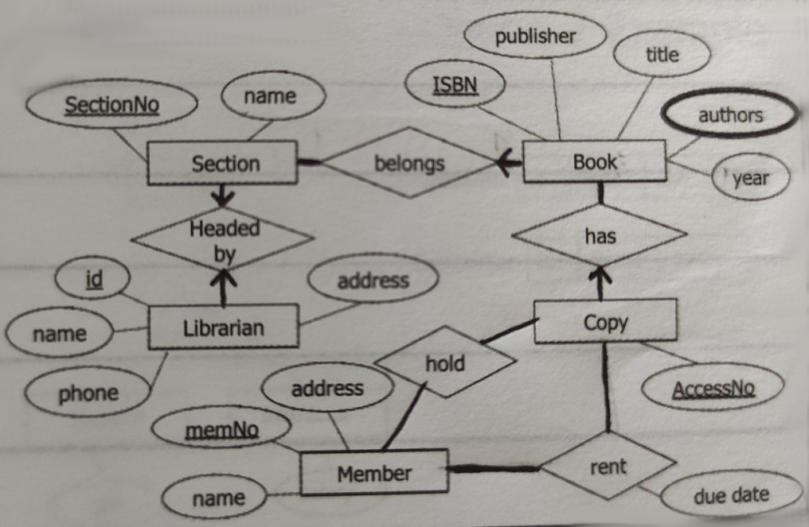
Activity 01
Map the EER diagram to a relational schema.
IE2042 | DMSS | Logical Design | Dr. Harinda Fernando

Slide 30
Logical Mapping For EER Relationships
IE2042 | DMSS | Logical Design | Dr. Harinda Fernando

Slide 31
ISA Relationship- Option 01
NIC
PERSON
name
PERSON (NIC, name)
ISA
STUDENT (NIC, gpa)
STUDENT
FACULTY MEM
FACULTY MEM (NIC, salary)
gpa
salary
Option 01 works for all constraints
IE2042 | DMSS | Logical Design | Dr. Harinda Fernando

Slide 32
ISA Relationship- Option 02
NIC
PERSON
name
ISA
STUDENT (NIC, name, gpa)
STUDENT
FACULTY MEM
FACULTY MEM (NIC, name, salary)
gpa
salary
Option 02 works when there is a covering constraint
IE2042 | DMSS | Logical Design | Dr. Harinda Fernando

Slide 33
ISA Relationship- Option 03
NIC
PERSON
name
ISA
PERSON (NIC, name, salary, gpa, p_type)
STUDENT
FACULTY MEM
gpa
Student / Faculty Mem
salary
Option 03 works for all disjoint
Good if subclasses have few attributes
IE2042 | DMSS | Logical Design | Dr. Harinda Fernando

Slide 34
ISA Relationship- Option 04
NIC
PERSON
name
ISA
STUDENT
FACULTY MEM
True / False
gpa
salary
PERSON (NIC, name, salary, gpa, faculty_mem, student)
Option 04 works for all overlapping constraints
IE2042 | DMSS | Logical Design | Dr. Harinda Fernando

Slide 35
Activity 02
Summarize the super class and sub class mapping
Option | Overlapping | Disjoint | Total | Partial
Option 1
Option 2
Option 3
Option 4
IE2042 | DMSS | Logical Design | Dr. Harinda Fernando

Slide 36
ISA Relationship- Multilevel
eID
EMPLOYEE
name
salary
ISA
All employees are either trainee or permanent = Covering = Total
No overlapping = Disjoint
Option 1 / 2 / 3 / 4
Option 2
TRAINEE
PERMANENT
period
Trainee (eid, name, salary, period, type)
bonus
ISA
Permanent (eid, name, salary, bonus)
No Overlapping = Disjoint
Option 1 / 3 / 4
Option 3
Undergraduate
Graduate
Can use different options for different parts
IE2042 | DMSS | Logical Design | Dr. Harinda Fernando

Slide 37
Aggregation
Plays
PLAYER
GAME
pID
PLAYER (pID)
gNo
GAME (gNo)
Plays (pID, gNo)
Wins
{
titleno
AWARD (titleno, pID, gNo)
AWARD
IE2042 | DMSS | Logical Design | Dr. Harinda Fernando

Slide 38
Aggregation
Works
EMPLOYEE
DEPARTMENT
eID
DEPARTMENT (dNo)
dNo
EMPLOYEE (eid, dNo)
Wins
AWARD (titleno, eid)
titleno
AWARD
IE2042 | DMSS | Logical Design | Dr. Harinda Fernando

Slide 39
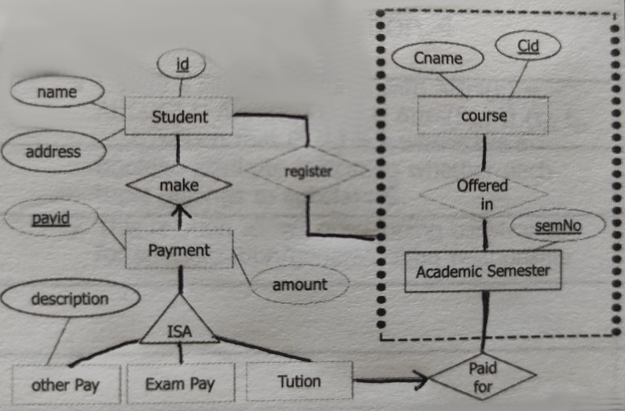
Activity 03
Map the EER diagram to a relational schema.
IE2042 | DMSS | Logical Design | Dr. Harinda Fernando

Slide 40

The End…
Complete the tutorial
Complete the lab sheet
Get ready for the spot test
IE2042 | DMSS | Logical Design | Dr. Harinda Fernando

